Slide 1



Peter Eijgermans
@EijgermansPeter

Slide 2

Agenda workshop
Choose your framework, ReactJS or Vue.js!
Component tree
Explain Vue.js
Explain ReactJS
Start Workshop

Slide 3
Building Tesla’s Battery Range Calculator
with ReactJS

Slide 4

Notes:
http://coenraets.org/present/react/#3.
http://slides.com/alexanderfarennikov/react-js-fundamentals/fullscreen#/20
https://scotch.io/tutorials/learning-react-getting-started-and-concepts

Slide 6
What to install?
Install node (https://nodejs.org/)

Slide 7
Github workshop!
git clone https://github.com/petereijgermans11/workshop-reactjs-vuejs.git
cd workshop-reactjs-vuejs
cd ./reactjs-app
npm install
npm start

Slide 8
Syntax Component
Class Welcome extends React.Component{
render( ) {
}
}
IN HTML:
<Welcome />
Notes:
Component = main building block React.
COMPONENT
Here, Welcome is a React component class. Always start component names with a capital letter.
A component takes in parameters, called props, and returns a (hierarchy of) views to display via the render method.
JSX:
The view: is a combination of HTML and Javascript!!! Called JSX
You can embed any JavaScript expression in JSX by wrapping it in curly braces.
----------------
Conceptually, components are like JavaScript functions. They accept arbitrary inputs (called "props") and return React elements describing what should appear on the screen.
Always start component names with a capital letter.
For example, <div /> represents a DOM tag, but <Welcome /> represents a component and requires Welcome to be in scope.

Slide 9
Syntax Component
Class Welcome extends React.Component{
render( ) {
return <div>Hello { this.props.name } </div>; → JSX
}
}
IN HTML:
<Welcome name="Sarah" />
Hello Sarah
Notes:
Component = main building block React.
COMPONENT
Here, Welcome is a React component class. Always start component names with a capital letter.
A component takes in parameters, called props, and returns a (hierarchy of) views to display via the render method.
JSX:
The view: is a combination of HTML and Javascript!!! Called JSX
You can embed any JavaScript expression in JSX by wrapping it in curly braces.
----------------
Conceptually, components are like JavaScript functions. They accept arbitrary inputs (called "props") and return React elements describing what should appear on the screen.
Always start component names with a capital letter.
For example, <div /> represents a DOM tag, but <Welcome /> represents a component and requires Welcome to be in scope.

Slide 10
Components are like JavaScript functions
fn(d) = V
Notes:
Conceptually, components are like JavaScript functions.
They accept arbitrary inputs (called "props") and return React elements describing what should appear on the screen.
Component = A function that receives data as input and returns a view.

Slide 11
Component: class
2 types of state:
this.props
Get input properties from parent component
this.state
Local state within components

Slide 12
export class Welcome extends React.Component {
render( ) {
return <h1>Hello, { this.props.name }</h1>;
}
}
class App extends React.Component {
render( ) {
return (
<div>
<Welcome name="Sarah" />
<Welcome name=”Ellis" />
<Welcome name=”Maria" />
</div>
);
}
}
ReactDOM.render(
<App />, document.getElementById('root')
);
Hello Sarah Hello Ellis Hello Maria
Notes:
Export?

Slide 13
this.props
Never changes props!
This is the responsibility for the parent

Slide 14
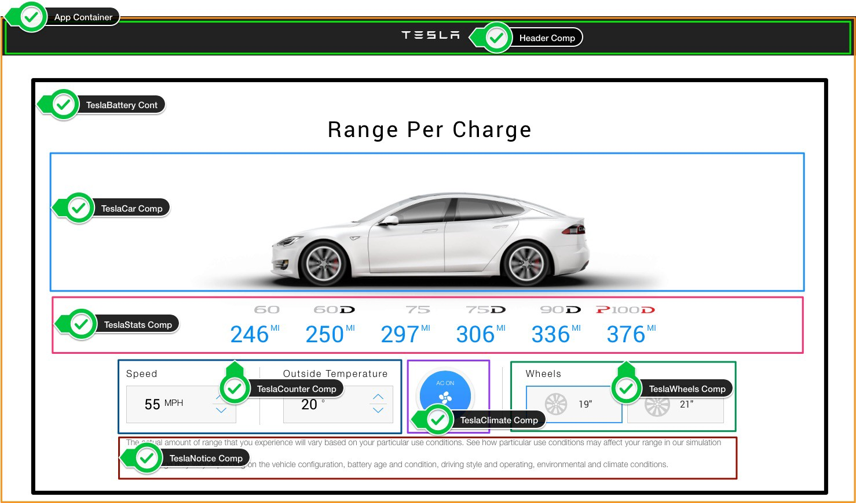

Slide 15
The UI is represented by a component tree
<App> --- Application entry point <Header></Header> <TeslaBattery> --- Container Component <TeslaCar /> --- Presentational Component <TeslaStats /> --- Presentational Component <TeslaCounter /> --- Presentational Component <TeslaClimate /> --- Presentational Component <TeslaWheels /> --- Presentational Component <TeslaNotice /> --- Presentational Component </TeslaBattery> </App>

Slide 16
Components tree
Index.js
App.js
Header
TeslaBattery
→ Container Component
props
props
props
props
props
TeslaCar
TeslaStats
TeslaCounter
TeslaClimate
TeslaWheels
Presentational Components

Slide 17
App.js component
import Header from './components/Header’;
class App extends React.Component { render() { return ( <div className="App"> <Header /> </div> ); } }

Slide 18
Header component
import React from 'react'; import './Header.css'; import logoUrl from '../../assets/logo.svg’;
const Header = ( ) => ( <div className="header"> <img src={logoUrl} alt="Tesla" /> </div> )
export default Header;
Notes:
Here, the component is in the form of a function (ES6 Arrow Function). A component declared in this form is called a functional component. If there is no state and the lifecyclemethod is not needed, it is a good pattern to declare it as a function type.
Functional components are suitable for Presentational Component because they have no state and they depend only on the props that is received from higher components.

Slide 19
Header

Slide 20
Project structure

Slide 21
Tesla Battery Component
Provides:
data = local state
props
actions
Notes:
Tesla Battery Component
Provides data
Passing this data via props to child components
Performing actions via callback functions (to change the state)

Slide 22
Components tree
Index.js
App.js
Header
TeslaBattery
→ Container Component
props
props
props
props
props
TeslaCar
TeslaStats
TeslaCounter
TeslaClimate
TeslaWheels
Presentational Components

Slide 23
class TeslaBattery extends React.Component { constructor () { super( );
this.state = { carstats: [], config: { speed: 55, temperature: 20, climate: true, wheels: 19 } } } render( ) { const { config } = this.state; return ( <form className="tesla-battery"> <h1>Range Per Charge</h1> <TeslaCar wheelsize={config.wheels}/> </form> ) } }
Notes:
Example destructuring: const { config } = this.state;
It takes the required value out of the object and makes a reference to it.
ow we will add the constructor method to the TeslaBattery container and set the initial value so that we can manage this state value and pass it to the subcomponent. The TeslaCarcomponent accepts the wheelsize input through props and renders the Tesla car image and spins the wheels.
-----
Before we set the state, we have to call super() in the constructor. This is because this is uninitialized before super() has been called.

Slide 24
State of the App
carstats (object array) : An array of battery numerical value objects ​by car model according to the currently selected condition value (speed, temperature, climate, wheel)
config (object): Currently selected conditions object (speed: 55, temperature: 20, climate: aricon on, wheel: 19)

Slide 25
State of the App

Slide 26
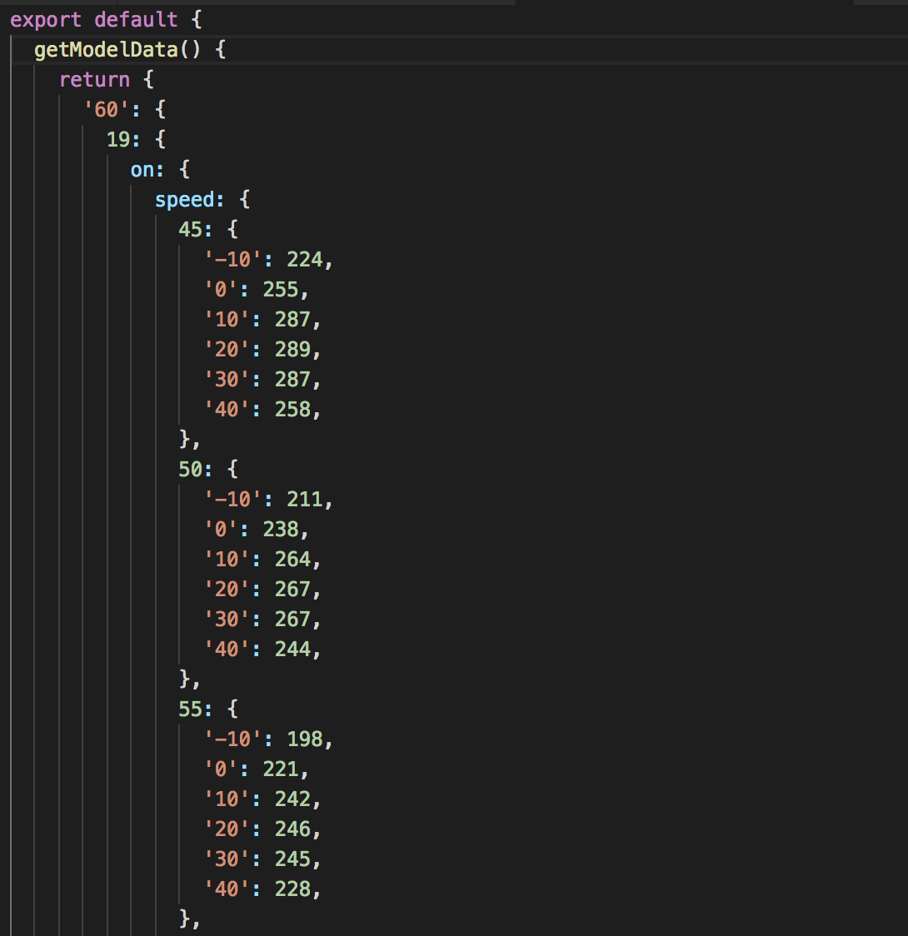
Tesla Battery Service
Provides the data
tesla_models = '60', '60D', '75', '75D', '90D', 'P100D’
Models –> wheels –> climate –> speed --> temparature

Slide 27
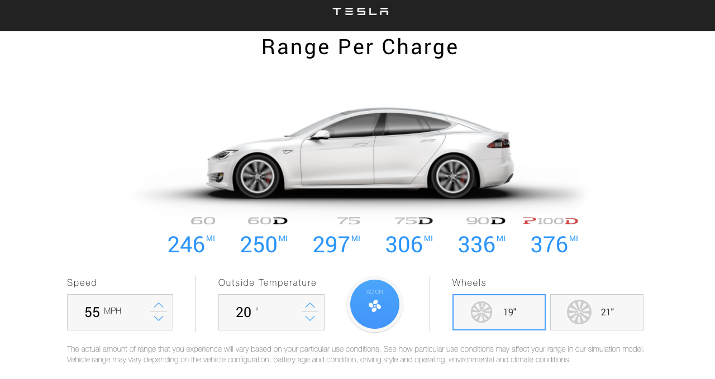
Exercise: check Tesla Battery Service

Slide 28
Changing State

Slide 29
Changing State
Do not! Change state with:
this.state = newState
Use:
this.setState( { … } )
Notes:
Otherwise react will not re-render, and possibly overwrite your state.

Slide 30

class WelcomeStatefull extends React.Component { constructor(){ super(); this.state = { message: "my friend !!" }; } render( ) { return <h1>Hello {this.state.message}!</h1>; } }
→ JSX
Notes:
To initialize the state, simply set this.state in the constructor() method of the class.
Our state is an object which in our case only has one key called message.
SUPER()
Before we set the state, we have to call super() in the constructor.
This is because this is uninitialized before super() has been called.

Slide 31
class WelcomeStatefull extends React.Component { constructor(){ super(); this.state = { message: "my friend !" }; this.updateMessage = this.updateMessage.bind(this); }
updateMessage( ) { this.setState({ message: "my friend (from changed state)!" }); }
render( ) { return <h1>Hello {this.state.message}!</h1>; } }
Notes:
Changing the state
To modify the state, simply call this.setState(), passing in the new state object as the argument.
We’ll do this inside a method which we’ll call updateMessage.
Note: To make this work, we also had to bind the this keyword to the updateMessage method. Otherwise we couldn’t have accessed this in the method.

Slide 32

class WelcomeStatefull extends React.Component { constructor(){ super(); this.state = { message: "my friend !" }; this.updateMessage = this.updateMessage.bind(this); }
updateMessage() { this.setState({ message: "my friend (from changed state)!" }); }
render( ) { return ( <div> <h1>Hello {this.state.message}!</h1> <button onClick={this.updateMessage}>Click me!</button> </div> ) } }
Notes:
The next step is to create a button to click on, so that we can trigger the updateMessage() method.
The updateMessage method then calls this.setState() which changes the this.state.message value.

Slide 34
class TeslaBattery extends React.Component { constructor () { super( );
this.statsUpdate = this.statsUpdate.bind(this);
this.state = { carstats: [], config: { speed: 55, temperature: 20, climate: true, wheels: 19 } } }
componentDidMount() {
this.statsUpdate();
}
statsUpdate( ) { const carModels = ['60', '60D', '75', '75D', '90D']; this.setState({ carstats: this.calculateStats(carModels) }) }
render( ) { const { config } = this.state; return ( <form className="tesla-battery"> <h1>Range Per Charge</h1> <TeslaCar wheelsize={config.wheels}/> </form> ) } }
Notes:
Example destructuring: const { config } = this.state;
It takes the required value out of the object and makes a reference to it.
ow we will add the constructor method to the TeslaBattery container and set the initial value so that we can manage this state value and pass it to the subcomponent. The TeslaCarcomponent accepts the wheelsize input through props and renders the Tesla car image and spins the wheels.
-----
Before we set the state, we have to call super() in the constructor. This is because this is uninitialized before super() has been called.

Slide 35
this.setState()
statsUpdate( ) { const carModels = ['60', '60D', '75', '75D', '90D']; this.setState({ carstats: this.calculateStats(carModels) }) }
Notes:
// Fetch model info from BatteryService and update ‘carstat’ state variable
The componentDidMount() method runs after the component output has been rendered to the DOM.

Slide 36
Tesla Car Component

Slide 37
passing props to Tesla Car Component
Index.js
App.js
Header
TeslaBattery
→ Container Component
props
props
wheelsize
props
props
props
TeslaCar
TeslaStats
TeslaCounter
TeslaClimate
TeslaWheels
Presentational Components

Slide 38
class TeslaBattery extends React.Component { constructor () { super( );
this.statsUpdate = this.statsUpdate.bind(this);
this.state = { carstats: [], config: { speed: 55, temperature: 20, climate: true, wheels: 19 } } }
componentDidMount() {
this.statsUpdate();
}
statsUpdate( ) { const carModels = ['60', '60D', '75', '75D', '90D']; this.setState({ carstats: this.calculateStats(carModels) }) }
render( ) { const { config } = this.state; return ( <form className="tesla-battery"> <h1>Range Per Charge</h1> <TeslaCar wheelsize={config.wheels}/> </form> ) } }
wheelsize
Notes:
Example destructuring: const { config } = this.state;
It takes the required value out of the object and makes a reference to it.
ow we will add the constructor method to the TeslaBattery container and set the initial value so that we can manage this state value and pass it to the subcomponent. The TeslaCarcomponent accepts the wheelsize input through props and renders the Tesla car image and spins the wheels.
-----
Before we set the state, we have to call super() in the constructor. This is because this is uninitialized before super() has been called.

Slide 39
Receiving props in Tesla Car Component

Slide 40
Receiving props in Tesla Car Component
const TeslaCar = (props) => ( <div className="tesla-car"> <div className="tesla-wheels"> <div className={`tesla-wheel tesla-wheel--front tesla- wheel--${props.wheelsize}`}></div> <div className={`tesla-wheel tesla-wheel--rear tesla- wheel--${props.wheelsize}`}></div> </div> </div> );
TeslaCar.propTypes = { wheelsize: React.PropTypes.number }
export default TeslaCar;

Slide 41
Component: lifecycles
Mounting
Updating
Unmounting
Notes:
lifecycle callbacks are useful when you want to render or update components, or to receive notifications at different stages of lifecycle.

Slide 42
Component: lifecycles
Mounting:
constructor()
componentWillMount()
render()
componentDidMount()
Notes:
https://facebook.github.io/react/docs/react-component.html

Slide 43
Component: lifecycles
Updating:
componentWillReceiveProps()
shouldComponentUpdate()
componentWillUpdate()
render()
componentDidUpdate()
Notes:
https://facebook.github.io/react/docs/react-component.html

Slide 44
Component: lifecycles
Unmounting:
componentWillUnmount()
Notes:
https://facebook.github.io/react/docs/react-component.html

Slide 45
Additional information
https://facebook.github.io/react/docs/hello-world.html
https://github.com/airbnb/javascript/tree/master/react

Slide 46
Github workshop!
git clone https://github.com/petereijgermans11/workshop-reactjs-vuejs.git
cd workshop-reactjs-vuejs
cd ./reactjs-app
yarn
yarn start
# Happy hacking ! ;-)

